Slide 1
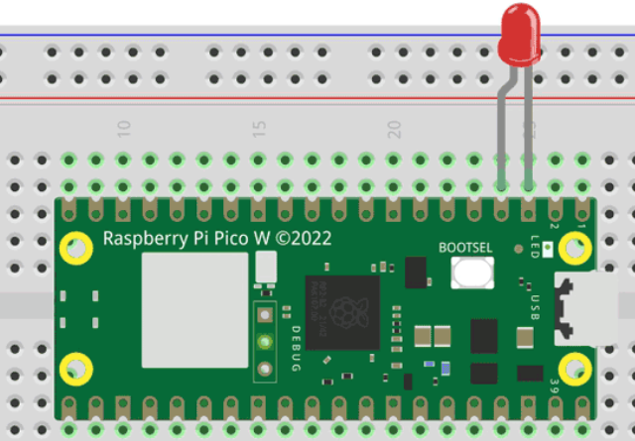
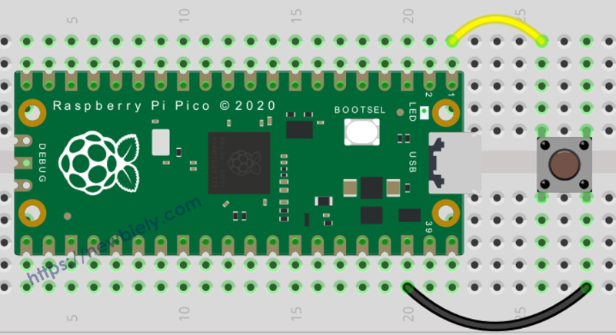
WEBSOCKET HTTP REQUEST
WEB SERVER
192.168.0.1
LOCAL
AREA
NETWORK
WEB SERVER
192.168.0.2
WEB SERVER
192.168.0.3
For the controller to turn on the LEDs
Connect individually to the IP Address
Send the http Request
Cannot turn on the LEDs simultaneously
One to One Connectivity

Slide 2
MQTT - Message Queuing Telemetry Transport
LAN
Device 1
LAN
MQTT
BROKER
Device 2
LAN
Device 3
For the controller to turn on the LEDs
Send the Message (Instruction to Broker)
Subscribers Receive the Message
Act on the Message Simultaneously
Allows Many to Many Connectivity

Slide 3
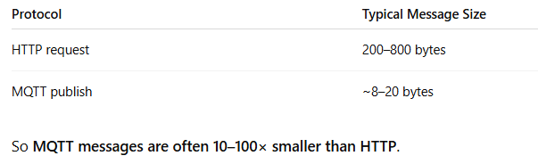
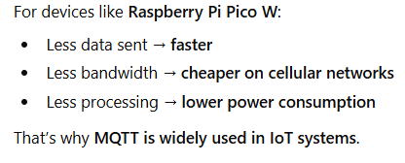

HTTP PROTOCOL VS MQTT
This post office is the MQTT Broker

Slide 4

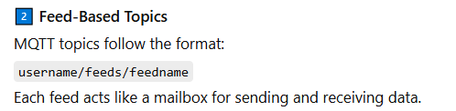
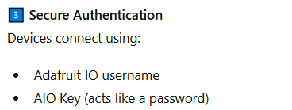
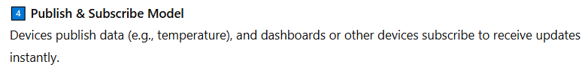
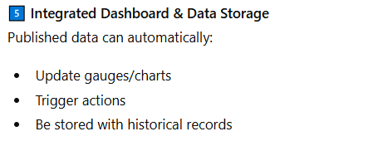
Adafruit IO – MQTT Broker

Slide 5
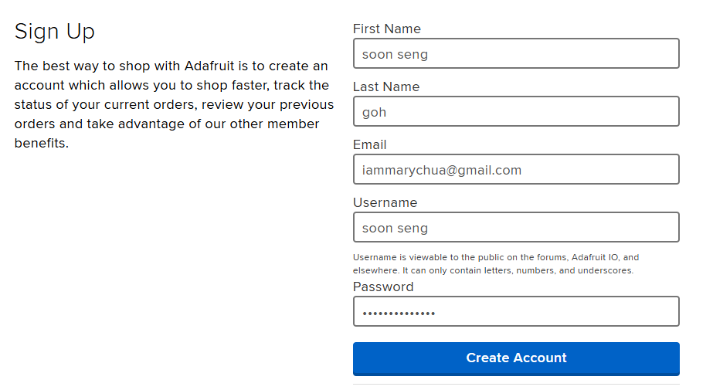
To use Adafruit MQTT Service
Create an Account
https://accounts.adafruit.com/users/sign_in

Slide 6
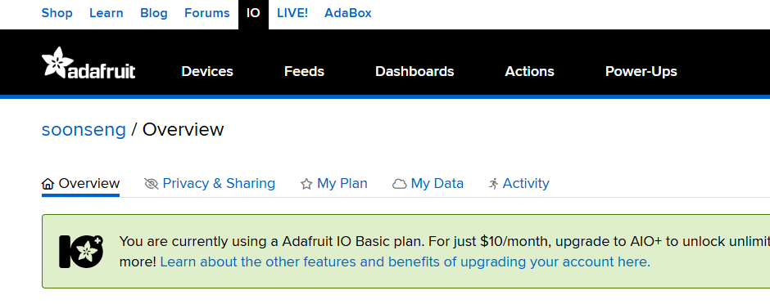
We need to create our unique API Key
Click Dashboards to Create Key

Slide 7
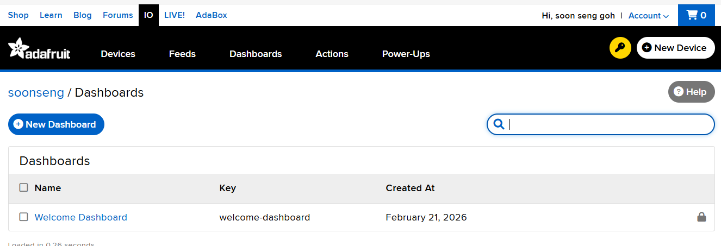
Click the Key Icon to Create

Slide 8
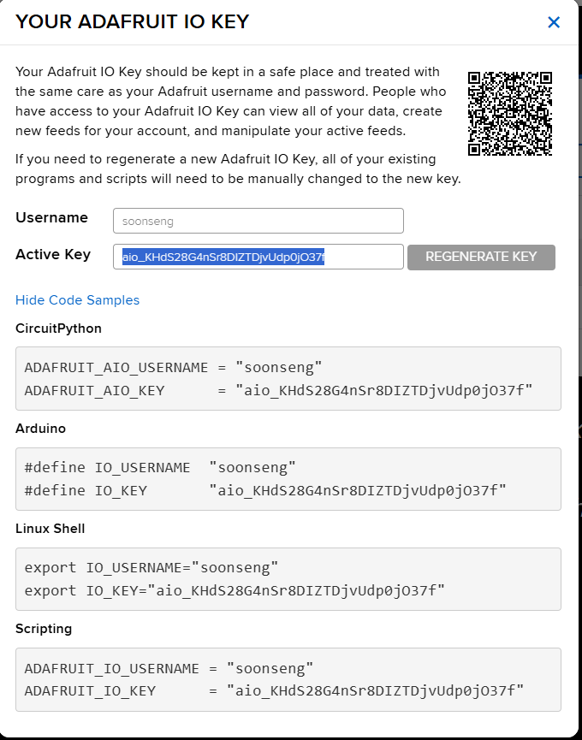
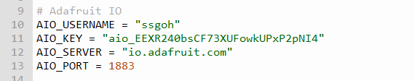
Adafruit will assign
An Active Key
For your user name
Copy and save the Username and
Active Key somewhere because we
Will need them in our program later

Slide 9
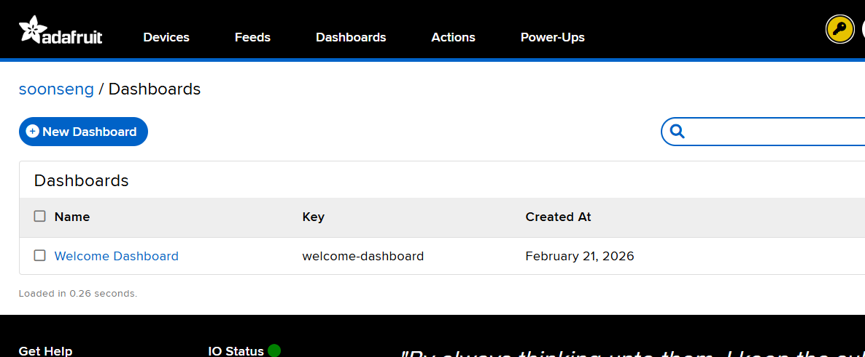
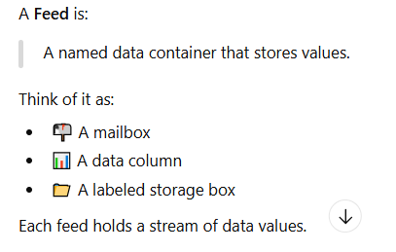
Next we will create the Feeds.

Slide 10

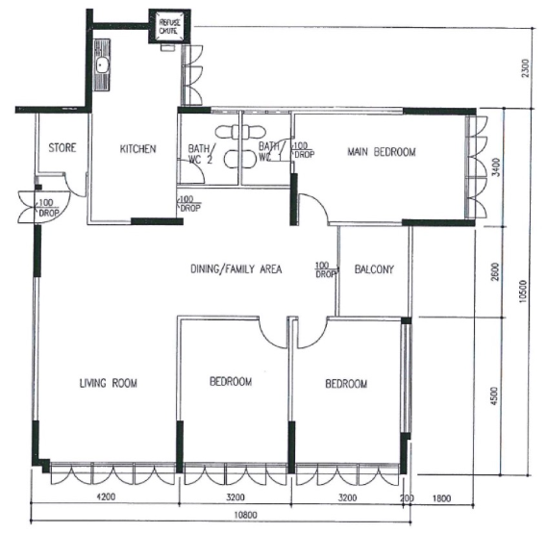
Username : soonseng
Adafruit IO – MQTT BROKER
Messages
28
ON
Temp
Pico1
Feeds

Slide 11
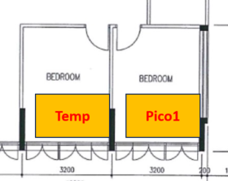

How MQTT works
ON
ON
PUBLISHER
MESSAGE
FEED
MESSAGE
SUBSCRIBER
Username + feed = Topic

Slide 12
Creating a Feed in Adafruit IO

Slide 13
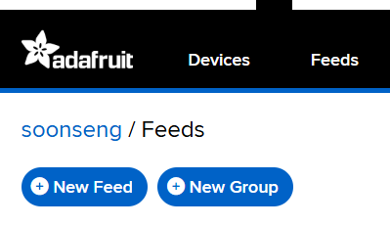
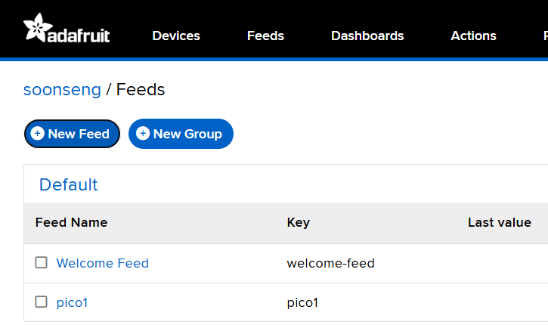
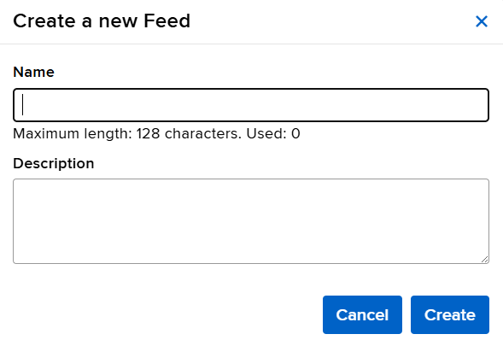
Click on Feeds and then New Feed
Pico1
You will see the feed appearing here

Slide 14
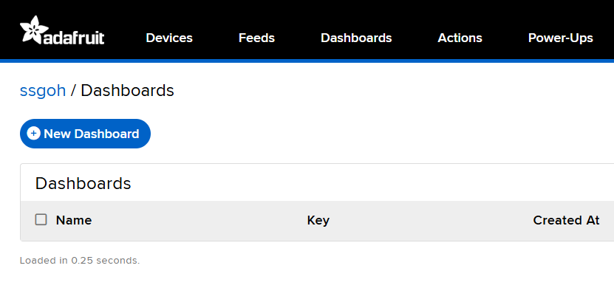
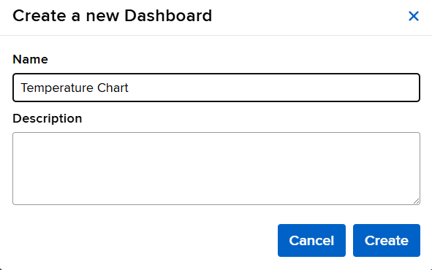
Create a Line Chart to display data

Slide 15
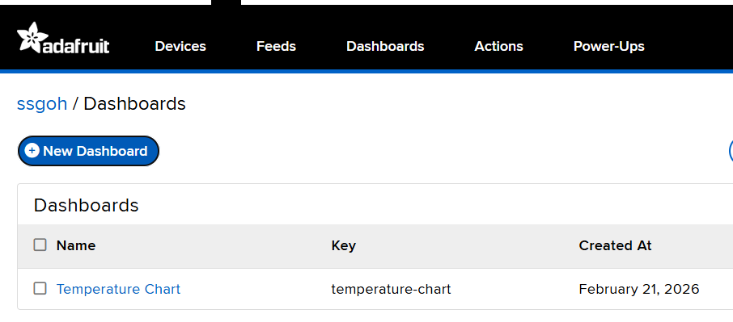
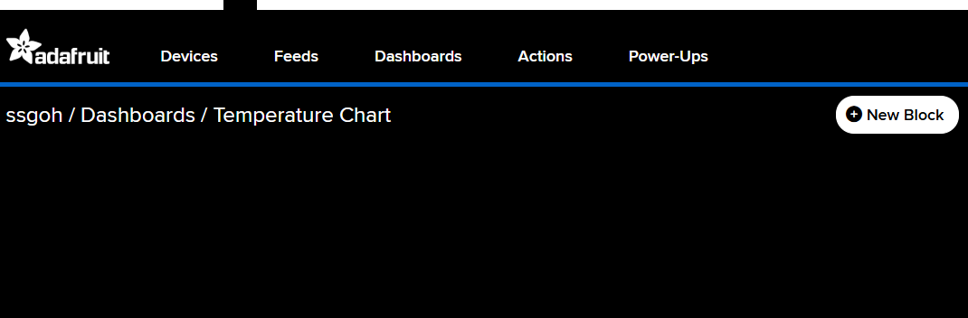

Slide 16
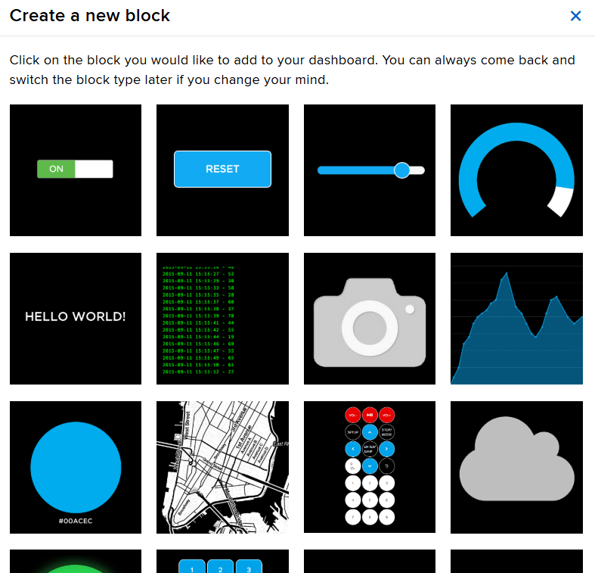
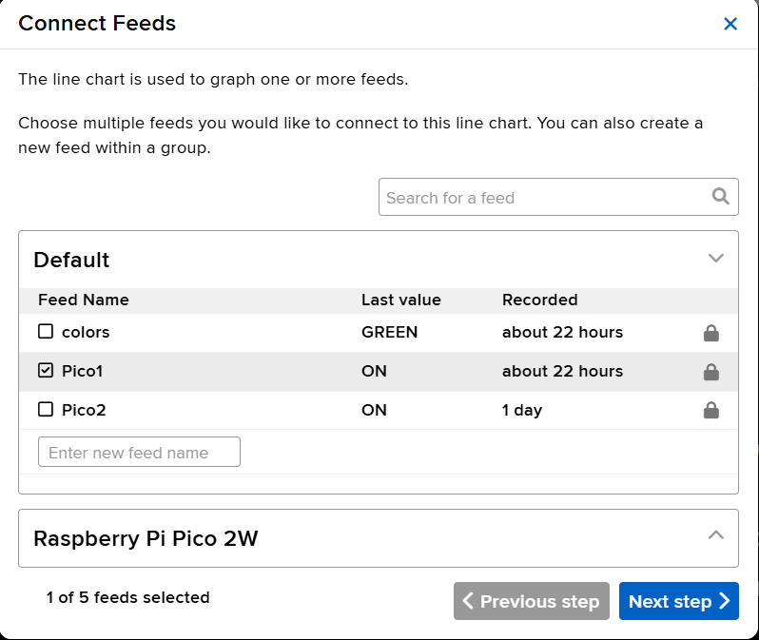
Select the feed you are using
To send data to, then click next step

Slide 17
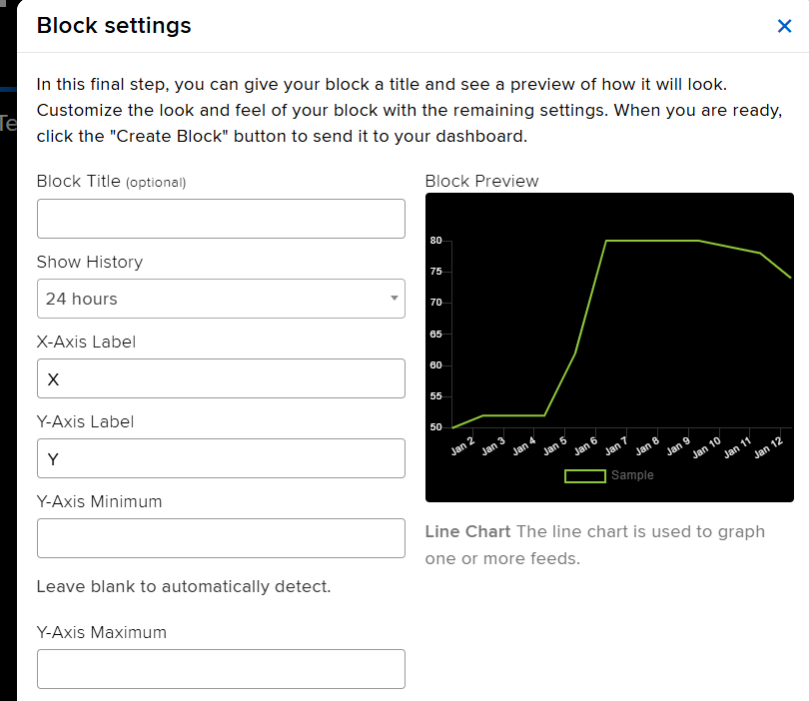

Slide 18
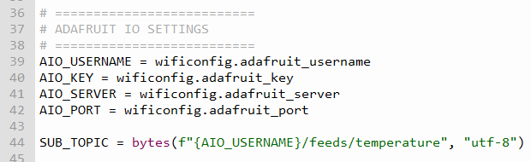
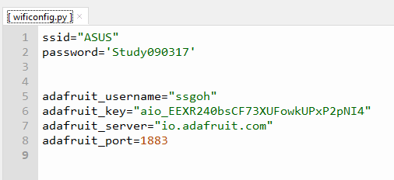
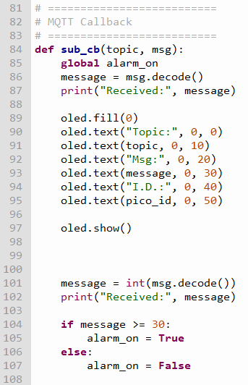
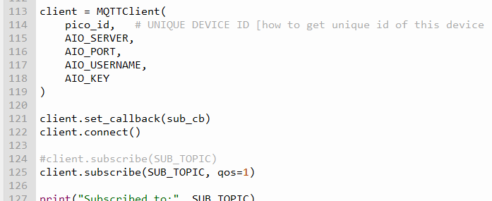
Setting up the MQTT Connection to Broker (SUBSCRIBER)
Message is decoded from binary to string
Connect and Listen for Incoming Messages from Broker

Slide 19
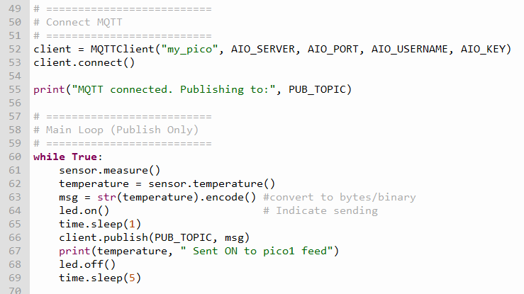

Setting up the MQTT Connection to Broker (PUBLISHER)
Connect and Publish Message to Broker
Temperature reading from the dht11.
Message must be converted to String
and encoded to binary/bytes

Slide 20
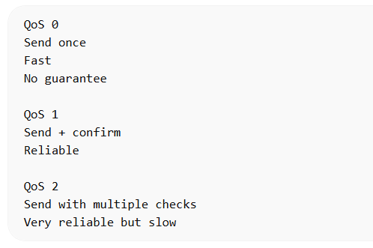
MQTT – QUALITY OF MESSAGE DELIVERY
Adafaruit io does not support qos 2

Slide 21
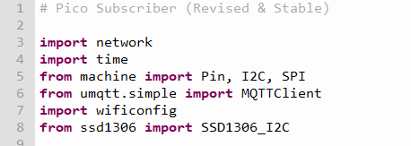
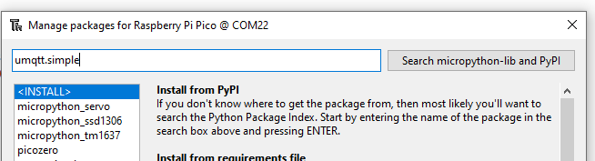
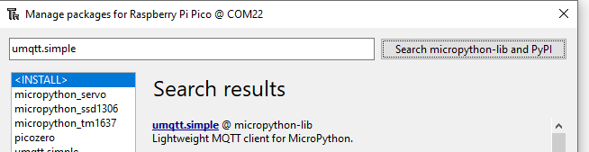
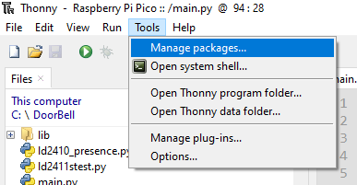
Installing the umqtt.simple package
Download using the package manager
Click umqtt.simple and then click Install to Install Package

Slide 22
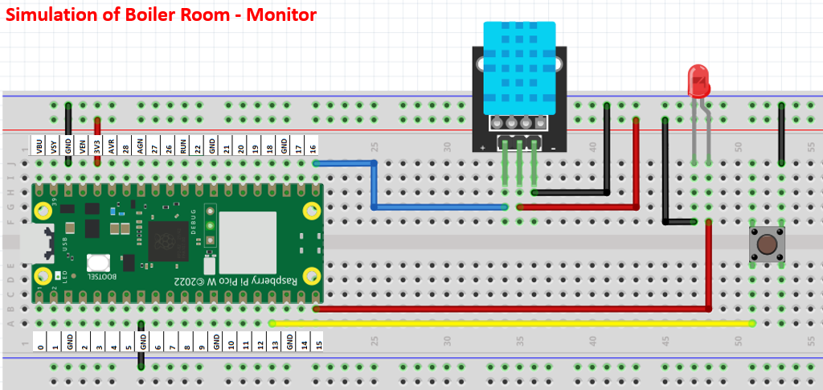
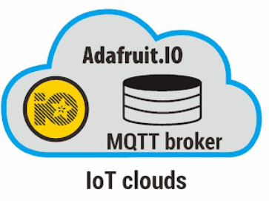
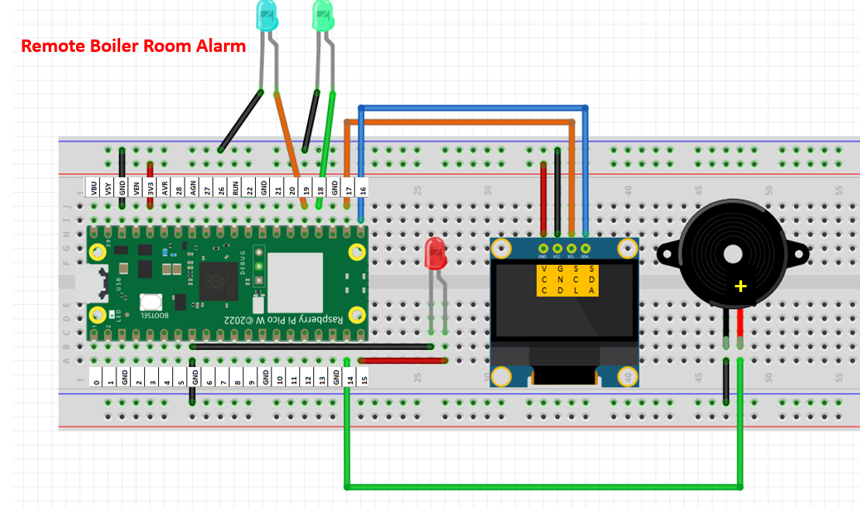
MQTT DEMO
boiler_room.py
feed
boiler_room_alarm.py

Slide 23
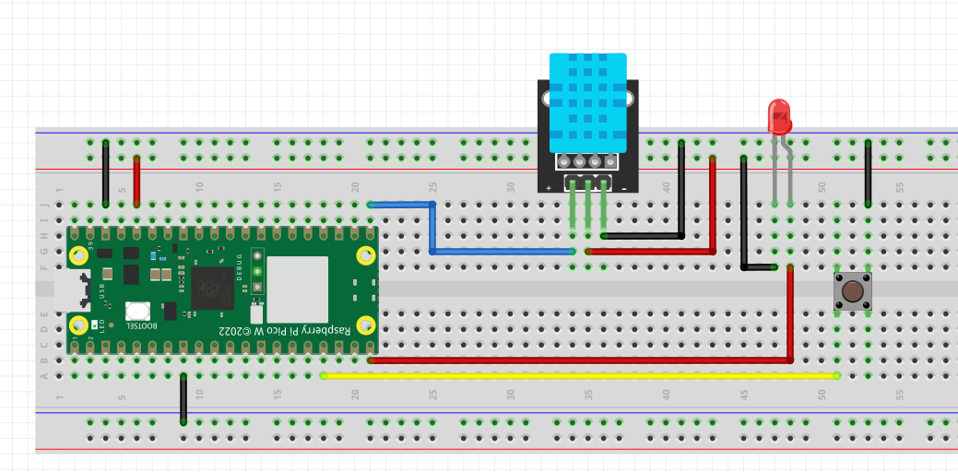
MQTT – Message Queue Telemetry Transport
Simulation of Boiler Room - Monitor

Slide 24
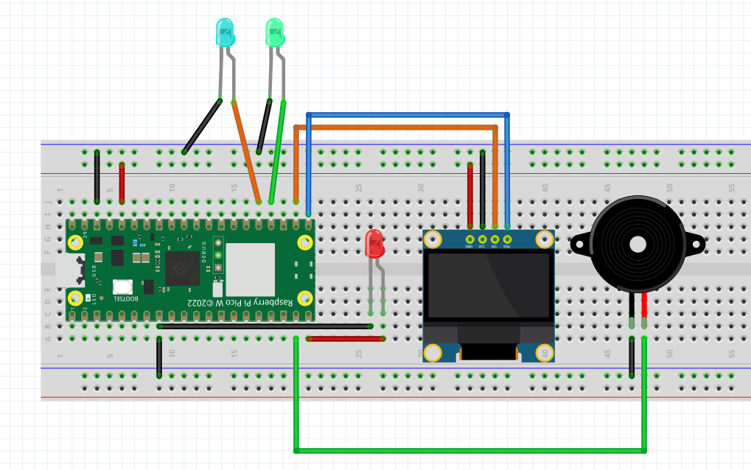

MQTT – Message Queue Telemetry Transport
Remote Boiler Room Alarm
+

